Slide 1
CA 7503 Software Testing

Slide 2
Lecture 5 : Structural Testing

Slide 3
“Structural” testing
Testing that is based on the structure of the program.
Also know as ‘white-box’ / ‘glass-box’ testing
Usually better for finding defects than for exploring the behaviour of the system.
Fundamental idea is that of basic block and flow graph - most work is defined in those terms.
Two main approaches:
Control oriented: how much of the control aspect of the code has been explored?
Data oriented: how much of the definition/use relationship between data elements has been explored.

Slide 4
Goal of “Structural” testing
Guarantee that all independent paths within a module have been exercised at least once.
Exercise all logical decisions one their true and false sides.
Execute all loops at their boundaries and within their operational bounds.
Exercise internal data structures to assure their validity.
Exercise all data define and use paths.

Slide 5
Basic Blocks
A basic block has at most one entry point and usually at most two exit points.
Can you think of exceptions to this?
We decompose our program into basic blocks. These are the nodes of the control graph.
The edges of the control graph indicate control flow - possibly under some conditions.
Sequence of consecutive statements such that: – Control enters only at beginning of sequence – Control leaves only at end of sequence.
No branching in or out in the middle of basic blocks

Slide 6
Control Flow Testing
Control flow testing uses the control structure of a program to develop the test cases for the program.
The test cases are developed to sufficiently cover the whole control structure of the program.
The control structure of a program can be represented by the control flow graph of the program.
Control flow graph (CFG) is a directed graph in which the nodes represent basic blocks and the edges represent control flow paths.
A control flow graph specifies all possible execution paths

Slide 7
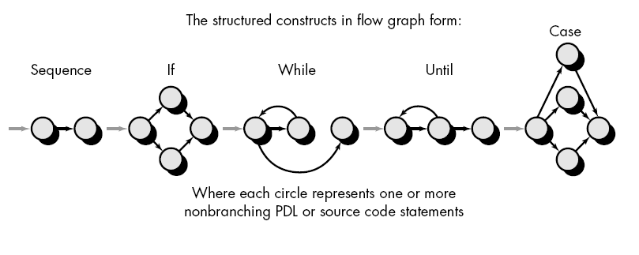
Flow Graph Representation

Slide 8
Flow Graph Representation
C
If C Then S1 else S2;
Sequential statement block
S1
S2
C
Case C of
L1: S1;
L2: S2;
…
Kn: Sn;
end;
C
If C Then S1;
S1
Sn
S1

Slide 9
Flow Graph Representation
C
I = 1
While C do S;
For loop:
for I = 1 to n do S;
F
T
S
S
yes
I <=n
no
S1
Do loop:
do S1 until C;
F
C
T

Slide 10
Control Flow Graph
The control flow graph G = (N, E) of a program consists of a set of nodes N and a set of edge E.
Each node represents a set of program statements. There are five types of nodes. There is a unique entry node and a unique exit node.
There is an edge from node n1 to node n2 if the control may flow from the last statement in n1 to the first statement in n2.
“nodes”
“edges”

Slide 11
Control Flow Graph: Nodes
A decision node contains a conditional statement that creates 2 or more control branches (e.g. if or switch statements).
A merge node usually does not contain any statement and is used to represent a program point where multiple control branches merge.
A statement node contains a sequence of statements. The control must enter from the first statement and exit from the last statement.

Slide 12
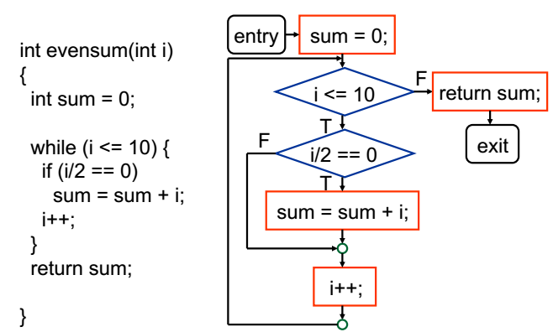
Control Flow Graph: An Example

Slide 13
Test Cases
A test case is a complete path from the entry node to the exit node of a control flow graph.
A test coverage criterion measures the extent to which a set of test cases covers a program.
Statement Coverage
Branch Coverage
Path Coverage

Slide 14
Using structural coverage
Spec
Enough
tests?
Software
Tests
Results OK?
What's
covered?
More tests
Coverage OK?
More tests
More tests
More tests
More tests
More tests
More tests
More tests
Stronger structural techniques (different structural elements)
Increasing coverage

Slide 15
The test coverage trap
Function exercised,
insufficient structure
better testing
Functional
testedness
Structure exercised,
insufficient function
% Statement % Decision % Condition
Combination
Structural testedness
100% coverage does not mean 100% tested!
Coverage is not Thoroughness

Slide 16
Statement coverage
Statement coverage
is normally measured
by a software tool.
percentage of executable statements exercised by a test suite
number of statements exercised
total number of statements
example:
program has 100 statements
tests exercise 87 statements
statement coverage = 87%
=
?
Typical ad hoc testing achieves 60 - 75%

Slide 17
Example of statement coverage
Test
case
Input
Expected
output
1
2
3
4
5
read(a)
IF a > 6 THEN
b = a
ENDIF
print b
1
7
7
As all 5 statements are ‘covered’ by
this test case, we have achieved
100% statement coverage
Statement
numbers

Slide 18
Decision coverage (Branch coverage)
Decision coverage
is normally measured
by a software tool.
percentage of decision outcomes exercised by a test suite
number of decisions outcomes exercised
total number of decision outcomes
example:
program has 120 decision outcomes
tests exercise 60 decision outcomes
decision coverage = 50%
=
False
?
True
Typical ad hoc testing achieves 40 - 60%

Slide 19
Paths through code
1
2
3
4
1
2
1
2
1
2
3
?
?
?
?
?
?

Slide 20
Paths through code with loops
1
2
3
4
5
6
7
8 ….
for as many times as it
is possible to go round
the loop (this can be
unlimited, i.e. infinite)
?

Slide 21
Cyclomatic Complexity
Cyclomatic complexity is a software metric used to measure the complexity of a program.
This metric measures independent paths through the program's source code. An independent path is defined as a path that has at least one edge which has not been traversed before in any other paths.
Cyclomatic complexity can be calculated with respect to functions, modules, methods or classes within a program.

Slide 22
Cyclomatic Complexity
Three ways to compute cyclomatic complexity:
The number of regions of the flow graph correspond to the cyclomatic complexity.
Cyclomatic complexity, V(G), for a flow graph G is defined as V(G) = E - N +2 , where E is the number of flow graph edges and N is the number of flow graph nodes.
Cyclomatic complexity, V(G) = P + 1, where P is the number of predicate nodes contained in the flow graph G.

Slide 23
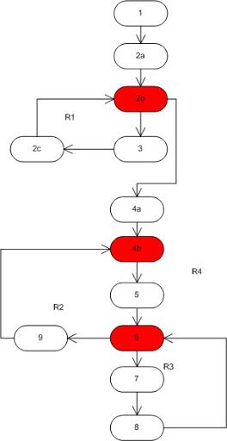
An Example
01. insertion_procedure (int a[], int p [], int N)
02. {
03. (1) Int i,j,k;
04. (2) for ((2a)i=0; (2b)i<=N; (2c)i++)
05. (3) p[i] = i;
06. (4) for ((4a)i=2; (4b)i<=N; (4c)i++)
07. {
08. (5) k=p[i];j=1;
09. (6) while (a[p[j-1]] > a[k]) {
10. (7) p[j] = p[j-1];
11. (8) j--
12. }
13. (9) p[j] = k;
14. }

Slide 24
An Example
Now, to calculate the cyclomatic complexity you use one of three methods:
Count the number of regions on the graph: 4
No. of predicates (red on graph) + 1 : 3 + 1 = 4
No of edges – no. of nodes + 2: 14 – 12 + 2 = 4

Slide 25
Example 1
Wait
Wait for card to be inserted
IF card is a valid card THEN
display “Enter PIN number”
IF PIN is valid THEN
select transaction
ELSE (otherwise)
display “PIN invalid”
ELSE (otherwise)
reject card
Valid card?
Yes
Display
“Enter..
No
Valid PIN?
Reject
card
Yes
Select
trans...
No
Display
“PIN in..
End

Slide 26
Example 2
Read A
IF A > 0 THEN
IF A = 21 THEN
Print “Key”
ENDIF
ENDIF
Read
A>0
Yes
A=21
Yes
No
No
Print
Cyclomatic complexity: _____
Minimum tests to achieve:
Statement coverage: ______
Branch coverage: _____
3
End
1
3

Slide 27
Example 3
Read
Read A
Read B
IF A > 0 THEN
IF B = 0 THEN
Print “No values”
ELSE
Print B
IF A > 21 THEN
Print A
ENDIF
ENDIF
ENDIF
A>0
Yes
B=0
No
Print
No
Yes
A>21
Yes
Print
Print
No
End
Cyclomatic complexity: _____
Minimum tests to achieve:
Statement coverage: ______
Branch coverage: _____
4
2
4

Slide 28
Example 4
A<0
Yes
Print
Read
Read A
Read B
IF A < 0 THEN
Print “A negative”
ELSE
Print “A positive”
ENDIF
IF B < 0 THEN
Print “B negative”
ELSE
Print “B positive”
ENDIF
No
Note: there are 4 paths
Print
B<0
Yes
Print
No
Print
End
Cyclomatic complexity: _____
Minimum tests to achieve:
Statement coverage: ______
Branch coverage: _____
3
2
2

Slide 29
Example 5
Read A
Read B
IF A < 0 THEN
Print “A negative”
ENDIF
IF B < 0 THEN
Print “B negative”
ENDIF
A<0
Yes
Read
Print
No
B<0
Yes
Print
No
End
Cyclomatic complexity: _____
Minimum tests to achieve:
Statement coverage: ______
Branch coverage: _____
3
1
2

Slide 30
Example 6
Read A
IF A < 0 THEN
Print “A negative”
ENDIF
IF A > 0 THEN
Print “A positive”
ENDIF
A<0
Yes
Print
Read
No
A>0
Yes
Print
No
End
Cyclomatic complexity: _____
Minimum tests to achieve:
Statement coverage: ______
Branch coverage: _____
3
2
2

Slide 31
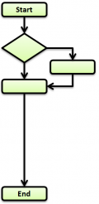
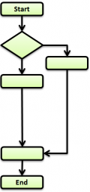
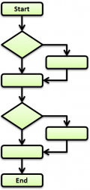
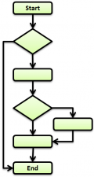
Solve it
Tell me in the following table how many test cases it needs to cover all statements, all branches, all paths or all basic paths:
 | Control Flow 1 | Control Flow 2 | Control Flow 3 | Control Flow 4
Branches
Statements
Paths
Basic Paths

Slide 32
Non-systematic test techniques
Trial and error / Ad hoc
Error guessing / Experience-driven
User Testing
Unscripted Testing
A testing approach that is only
rigorous, thorough and systematic
is incomplete

Slide 33
Error-Guessing
always worth including
after systematic techniques have been used
can find some faults that systematic techniques can miss
a ‘mopping up’ approach
supplements systematic techniques
Not a good approach to start testing with

Slide 34
Error Guessing: deriving test cases
Consider:
past failures
intuition
experience
brain storming
“What is the craziest thing we can do?”

Slide 35
Summary: Key Points
Test techniques are ‘best practice’: help to find faults
Black Box techniques are based on behaviour
White Box techniques are based on structure
Error Guessing supplements systematic techniques

